Slide 1

Friendly Coding
Writing code that's easy for humans to understand and maintain

Slide 2
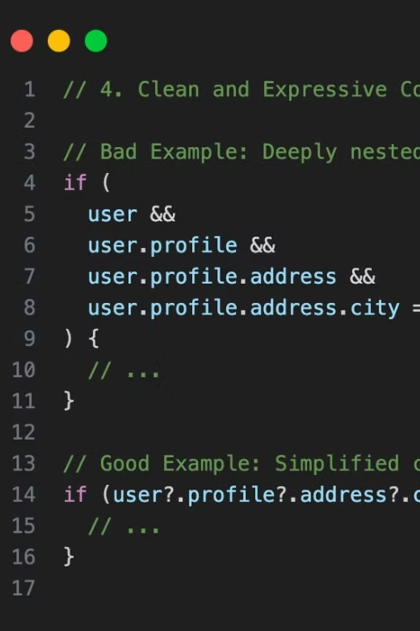
What is Friendly Coding?
Friendly coding means writing code that other people — and your future self — can easily read, understand, and modify. It prioritizes clarity and maintainability alongside correctness.
✅ Friendly Code
❌ Unfriendly Code
Clear variable names
Cryptic abbreviations
Simple logic
Confusing structure
Consistent style
Inconsistent patterns
Helpful documentation
No comments

Slide 3




Why Use Friendly Coding?
Writing readable code isn't just about aesthetics — it directly impacts your team's productivity, code quality, and long-term success.
Easier Teamwork & Faster Onboarding
Fewer Bugs, Simpler Reviews
Long-term Maintainability
Clear code makes bugs easier to spot during reviews and reduces the likelihood of introducing new issues.
Code that's easy to understand today will still make sense six months from now when requirements change.
New team members can understand and contribute to the codebase quickly, reducing ramp-up time from weeks to days.
"Code is read more often than it's written."

Slide 4








Core Principles: The 4 Pillars
These four foundational principles guide every decision you make when writing friendly code.
Clear Naming
Small Functions
Express intent with descriptive names
One job per method keeps things focused
calculateInterest beats cInt
Each function does one thing well
Names reveal purpose instantly
Easy to test and reuse
Meaningful Comments
Consistency & Testing
Explain "why," not "what"
Follow conventions and validate behavior
Document intent and reasoning
Uniform style across the codebase
Let code speak for itself where possible
Tests document expected behavior

Slide 5
Java Examples: Show, Don't Tell
Let's see friendly coding principles in action with real Java code transformations.
Example 1: Clear Naming
❌ Before
✅ After
int c = calc(a, b);
int monthlyInterest = calculateMonthlyInterest( principal, months );
What does c represent? What are a and b? The intent is completely hidden.
Now it's crystal clear what this code does and what each parameter means.
Example 2: Small Functions
❌ Before
✅ After
// Does everything at onceprocessOrder(order);
// Split into focused stepsvalidateOrder(order);chargePayment(order);sendReceipt(order);
A single monolithic function handling validation, payment, and notifications — hard to test and modify.
Each function has one clear responsibility, making the code self-documenting and testable.

Slide 6


How to Practice Friendly Coding
Building habits takes practice. Start with these actionable steps to transform your coding style.
01
Use Clear Names & Consistent Formatting
Choose descriptive variable and method names. Apply consistent indentation and spacing throughout your code.
02
Keep Functions Small & Focused
Break large methods into smaller, single-purpose functions. Aim for methods that fit on one screen.
03
Write Meaningful Comments & Simple Tests
Document complex logic and business rules. Write tests that serve as executable documentation.
04
Review Code with Teammates
Get feedback through code reviews. Learn from others and share your knowledge.
Helpful Tools
Use linters like Checkstyle and formatters like Google Java Format to maintain consistency automatically across your team.

Slide 7
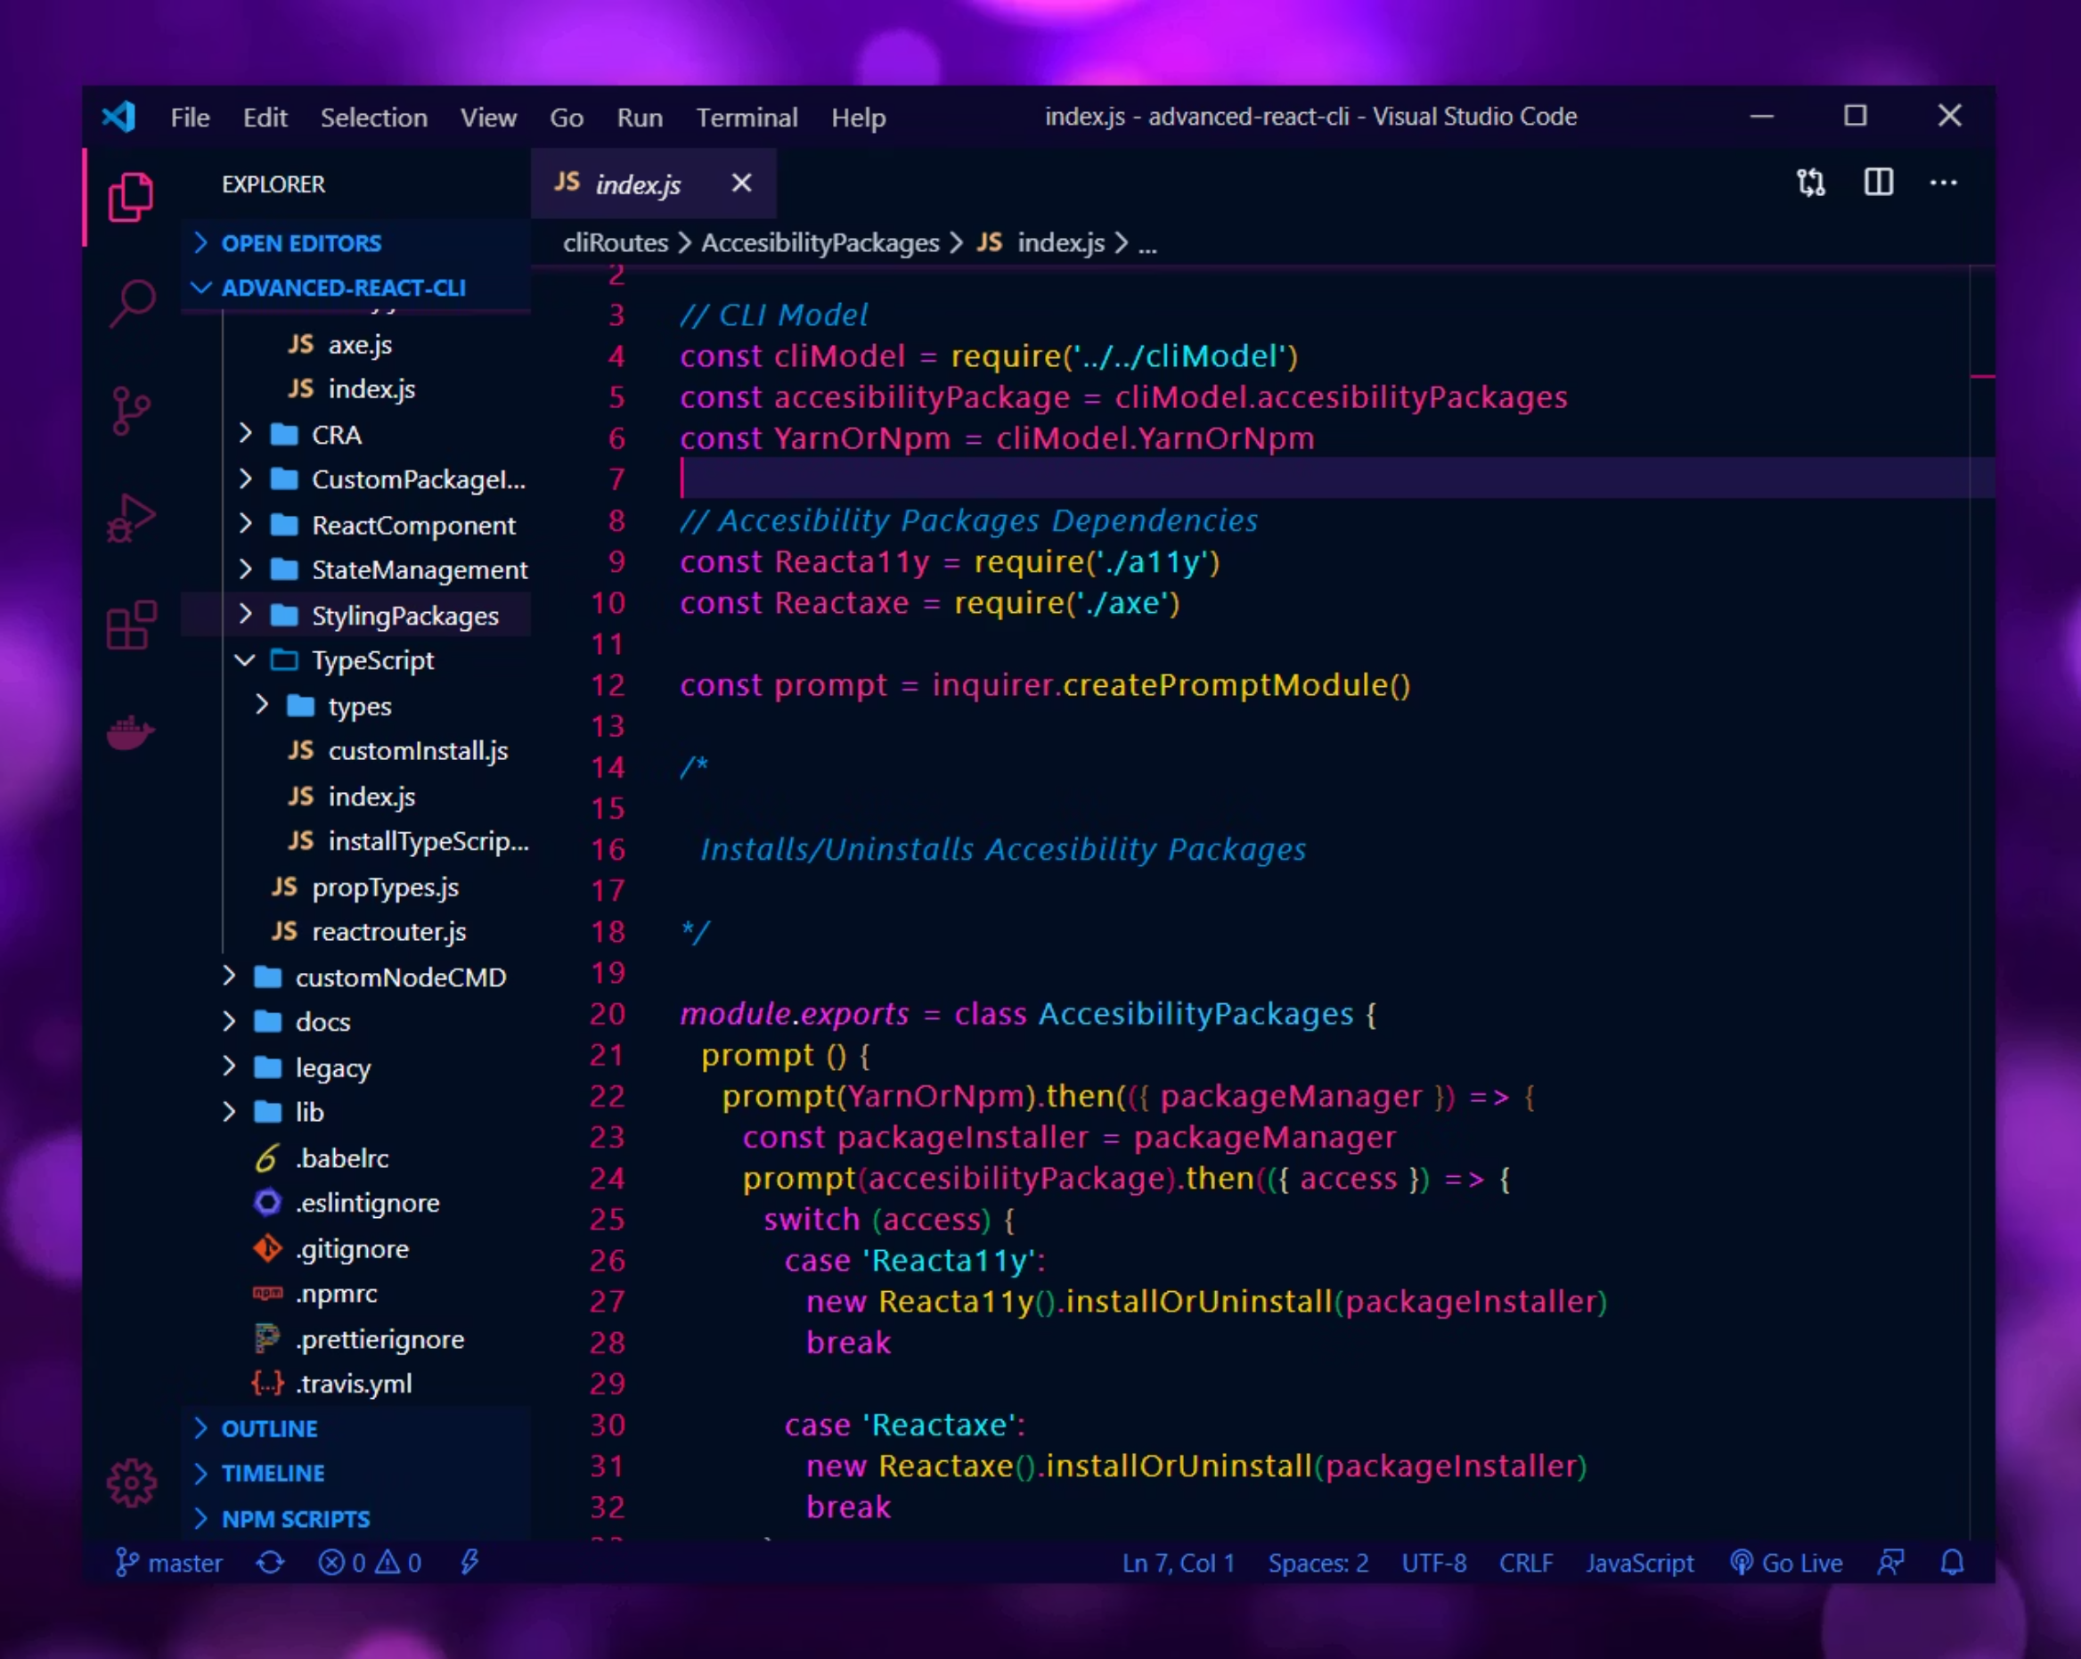
Thank You for Your Attention!
"Any fool can write code that a computer can understand. Good programmers write code that humans can understand."
— Martin Fowler
Happy Coding !

